Slide 1

Improving Credit Monitoring and Loan Approval Processes
Data Analysis Project for Financial Services
Keith Billman
January 2025

Slide 2

Presentation Overview
Project Background, Data & Objectives
Method & Data Analysis and Structure
Task 1: Risk-Based Credit Monitoring
Task 2: Loan Approval Analysis
Risk Score Distribution
Policy Compliance Analysis
Next Steps & Implementation Timeline

Slide 3
Cleaning the Data
Checking for Duplicate Entries
Check for Missing Values
Verifying Data Types and Ranges
Check for Invalid Values in Numeric Columns
Check for Unexpected Categorical Values
Check for Logical Inconsistencies
Validate Relationships between Columns

Slide 4
Project Background & Objectives
Current Challenges:
- Inefficient credit monitoring process (same for all borrowers)
- Concerns about loan approval consistency and risk-sensitivity
- Manual risk assessment leading to inconsistencies
- Lack of standardized monitoring frequencies
Project Goals:
- Develop data-driven approach for borrower-specific credit monitoring
- Analyze loan approval patterns to verify policy compliance
- Evaluate risk-sensitivity of loan pricing
- Implement automated scoring systems

Slide 5

Method & Data
Dataset Analysis:
Credit risk dataset with 12 key variables
Primary Key: credit_ID for Unique Loan Identification
Variables include: Age, Income, Loan Details, Credit History
Created SQL Queries for Systematic Analysis
Implemented Scoring Systems for Risk and Approval

Slide 6
Database Structure
Key SQL Components:
Common Table Expressions (CTEs) for Scoring
JOIN Operations for Data Correlation
CASE Statements for Score Calculation
Aggregate Functions for Statistics

Slide 7
Task 1: Risk-Based Credit Monitoring
Risk Scoring System (0-12 points):
Previous defaults (3 points)
Loan-to-income ratio (2 points)
Employment length (2 points)
Credit history length (2 points)

Slide 8
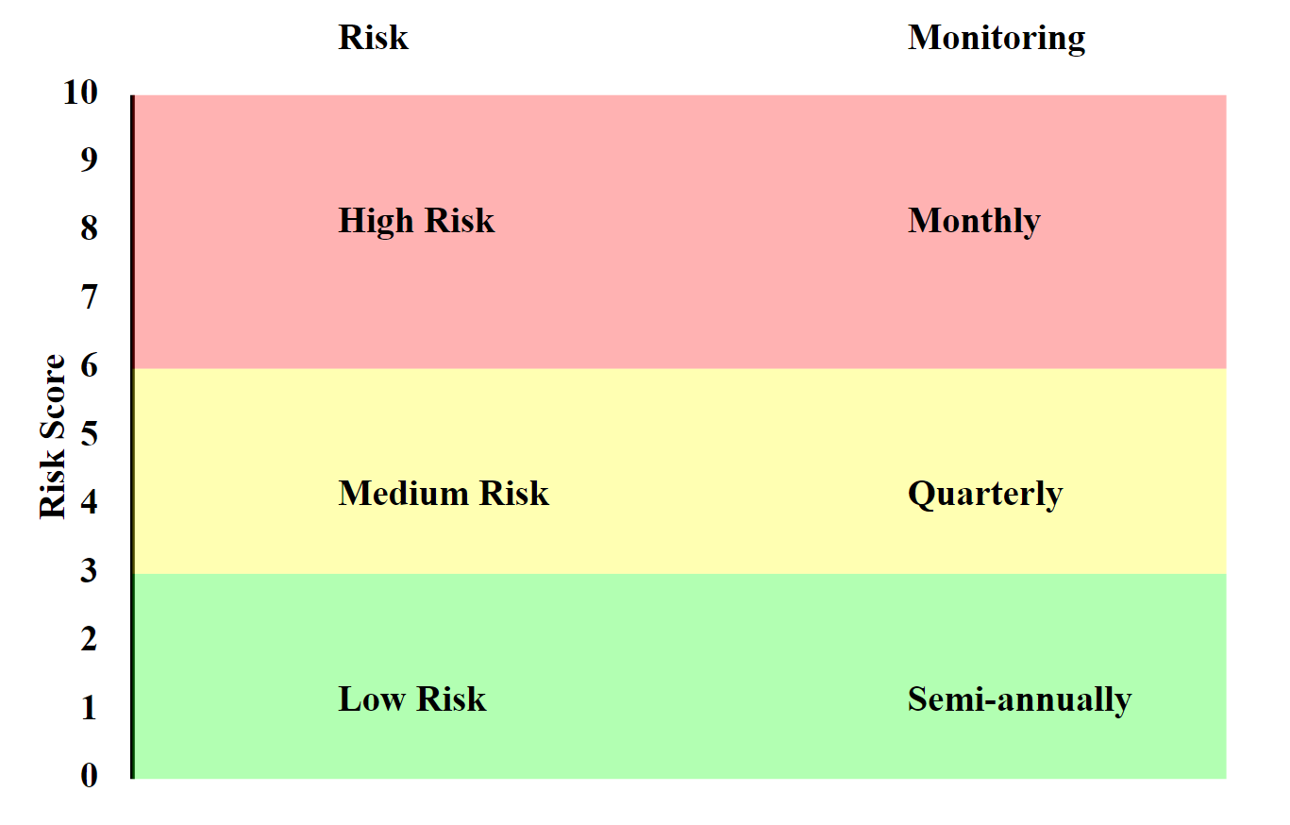
Risk
Score
Determines
Monitoring
Frequency

Slide 9
Approval Scoring System (0-12 points)
Income level (0-3 points)
Debt-to-Income ratio (0-3 points)
Credit history (0-3 points)
Employment length (0-2 points)
Age (0-1 point)
Task 2: Loan Approval Analysis

Slide 10
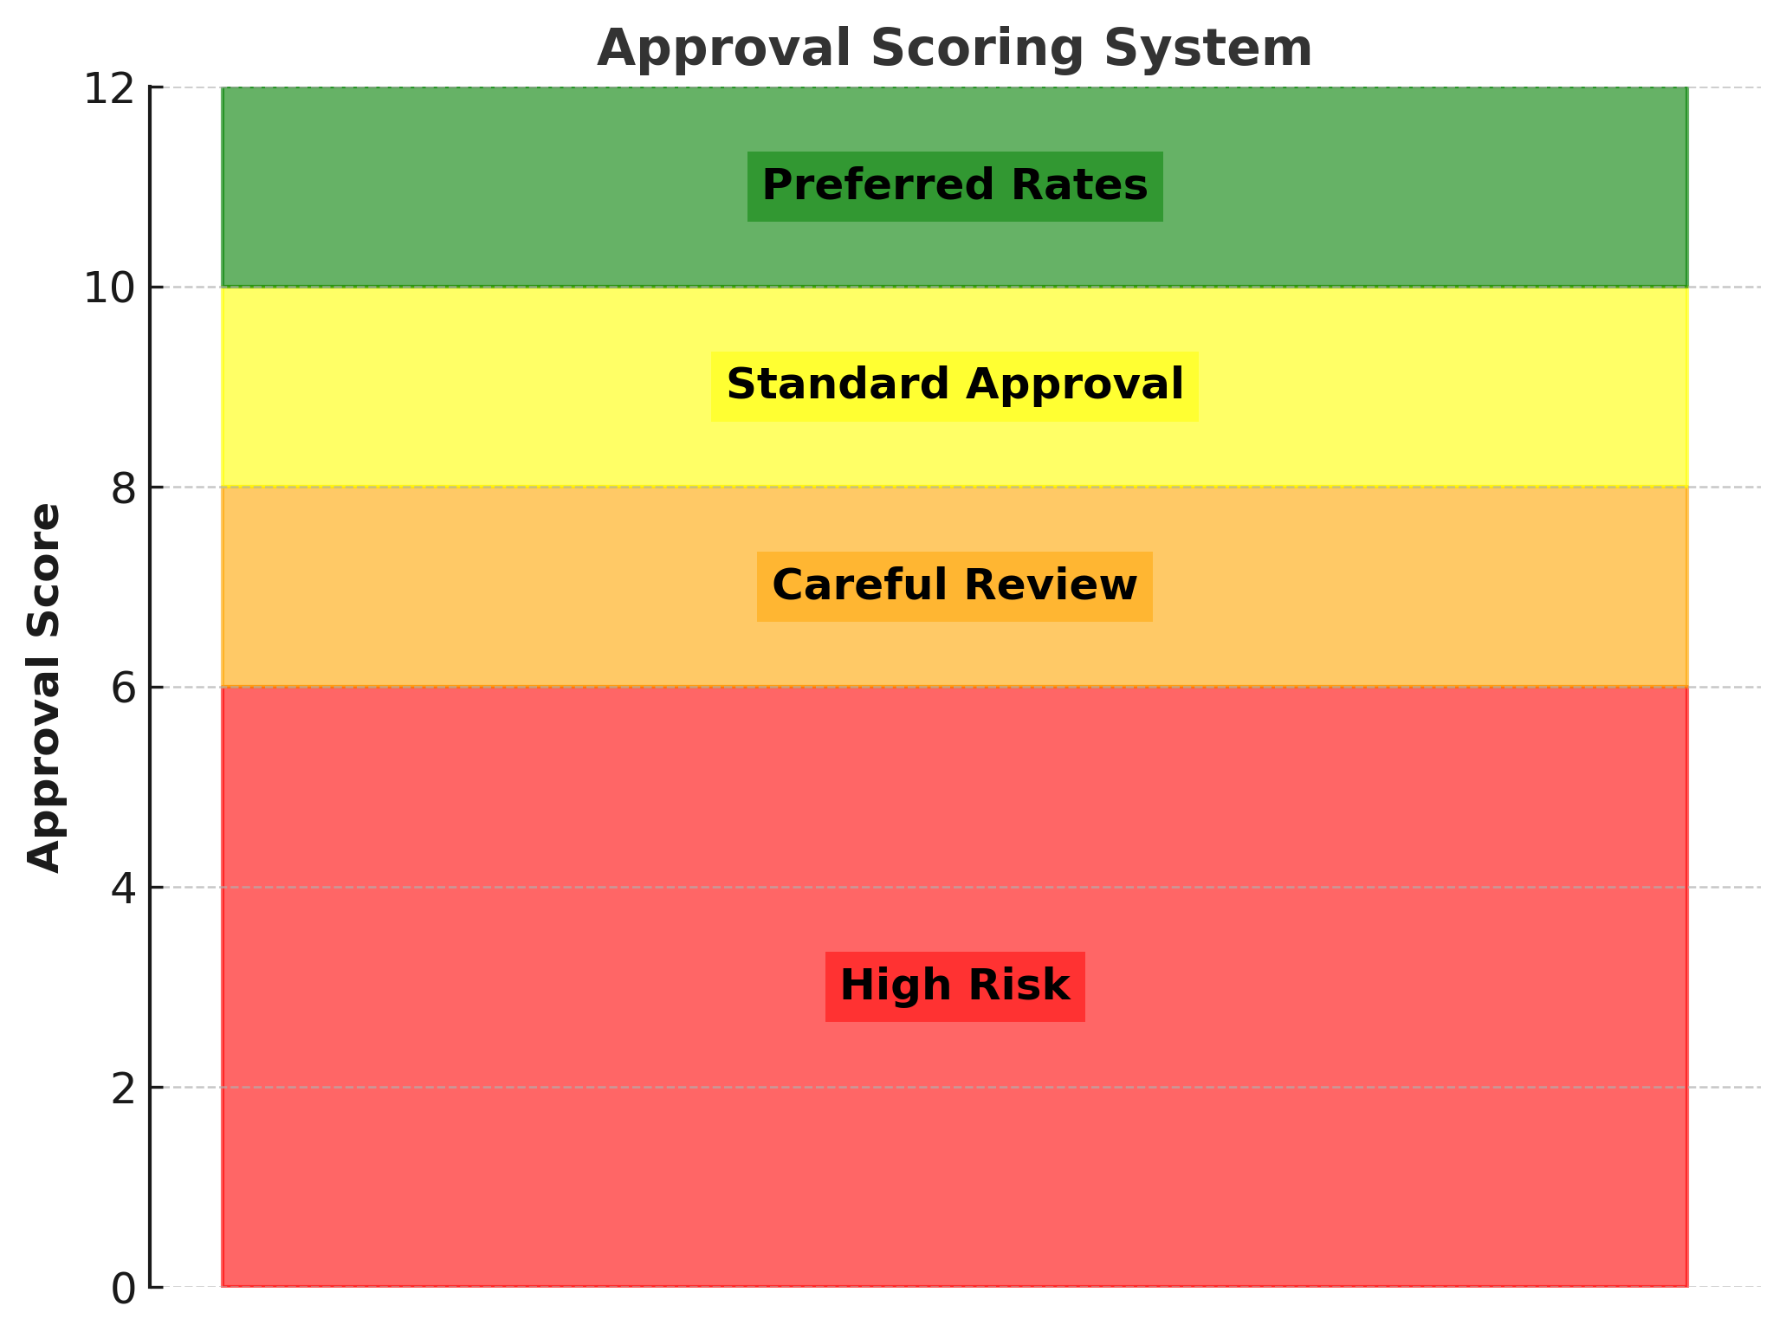
Approval
Score
Decides
Loan
Availability
and
Price

Slide 11
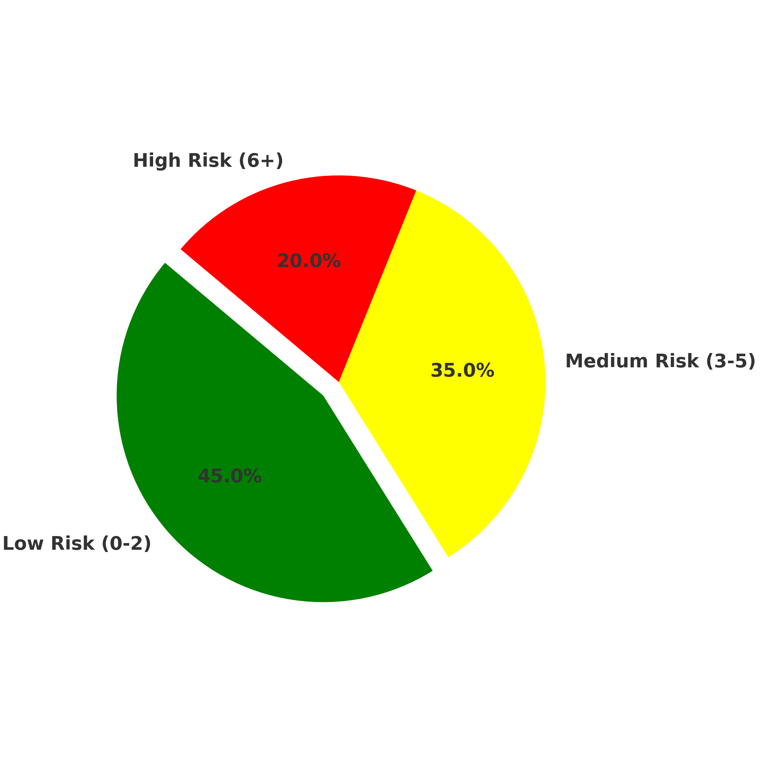
Portfolio
Risk
Distribution

Slide 12
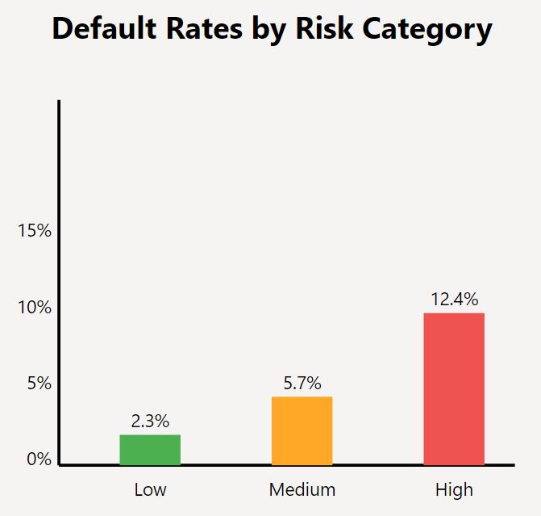

Slide 13
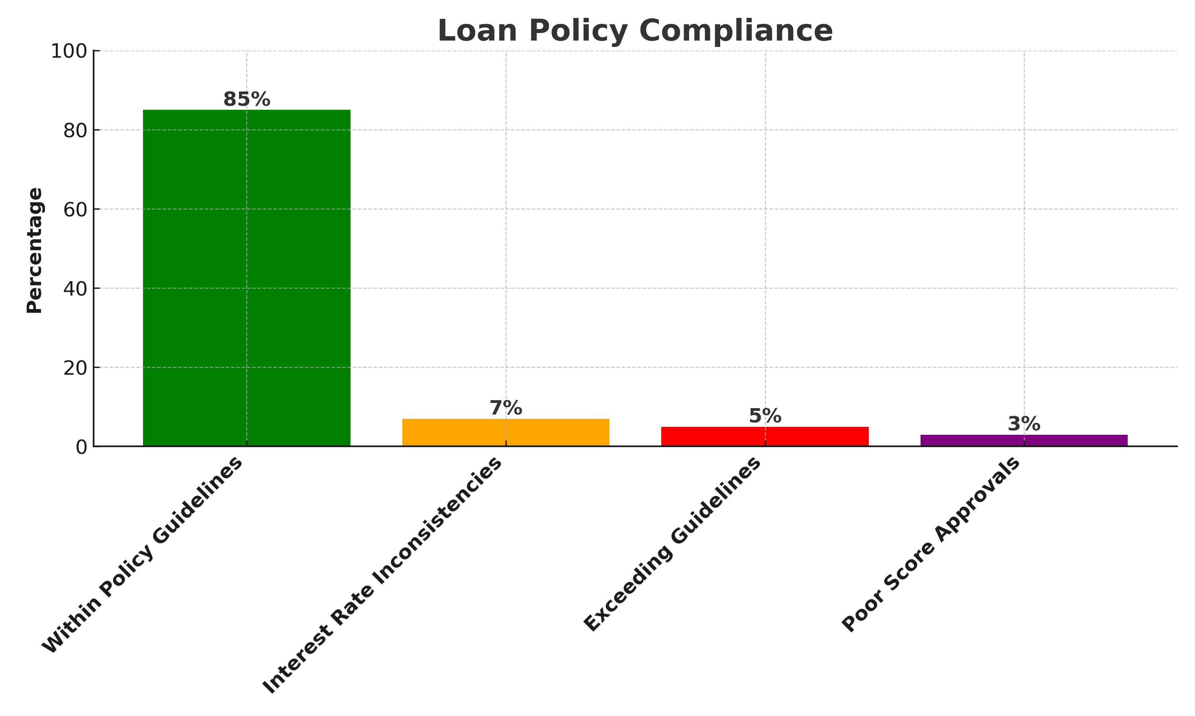

Slide 14

Next Steps Timeline
Month 1: Technical Setup & Staff Training
Database Configuration
Automating Risk Assessment
Hands-on Practice for Staff
Month 2: System Integration and Testing
Monitor Effectiveness
Month 3: Rollout and Updates
Further Staff Training
Update Documents
Tracking & Analysis
Review & Make Adjustments
Performance Review

Slide 15

Questions?
Thank you for your attention!

